Slide 1


Slide 2
Welcome and Overview
What We Do
We work with school administrators and teachers to support the educational experience of students, support faculty and staff, provide learning opportunities for parents, and enhance the school community overall.
Members
All parents of St Patrick Catholic School Students are automatically members of the PTO.
How We Are Organized
The St Patrick PTO consists of a board of five members and committees for the events and functions we serve for the school.

Slide 3
PTO Board
President: Megan Stovall (stpatptopresident@gmail.com)
Vice President: Alisa Burch (stpatptovicepresident@gmail.com)
Treasurer: Jessica Kramer (stpatptotreasurer@gmail.com)
Secretary: Erin Fogarty (stpatptosecretary1@gmail.com)
Director of Communication and Engagement: Katie Moody (stpatptocommunications@gmail.com)

Slide 4
Committee Overview
Back to School Fair | Open House
Catholic Schools Week | Recess Equipment
Celtic Welcome | School Spirit (decorates common areas of the school for holidays and events)
Emergency Buckets | School Supply Kits
Field Day | Spirit Wear
Fundraising | St Patrick's Day
Graduation | Sunshine (coordinates teach lounge restocks, life event recognition, meals for teachers for certain events)
Used Uniform | Teacher Appreciation Week
Hospitality
Lost and Found

Slide 5
How We Communicate
Weekly Section in the PONY (school newsletter)
PTO Meetings
Digital Calendar
Social Media
Instagram
Facebook

Slide 6
2026 - 2027 PTO Meeting Dates
August 20st - 8:00 am
November 5th - 8:00 am
March 11th - 6:00 pm
April 22th - 8:00 am
Meetings will take place in Schindler Hall or Miles Meeting Room with a virtual option available to those who cannot attend live.

Slide 7
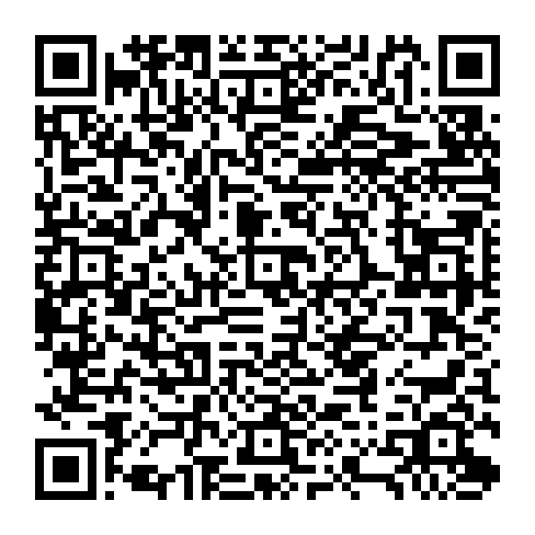
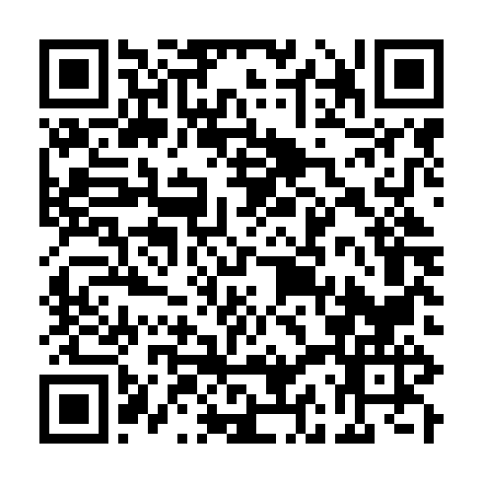
QR Codes
icalendar
Google calendar
Social Media

Slide 8
How We are Funded
Annual Fundraiser - ‘COLOR WALK’ our fundraising period begins August 20th
Corporate sponsorship opportunities are available.
Spirit Wear Sales
School Supply Kit Sales
Kroger Community Rewards
Box Tops

Slide 9
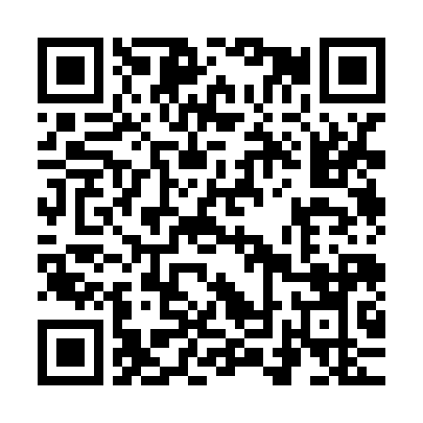
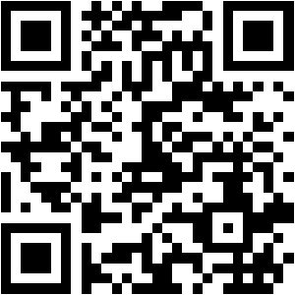
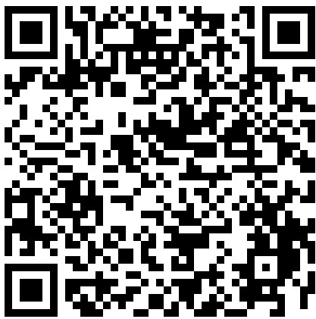
QR Codes
Kroger Community Rewards
Box Tops
Spirit Wear Site

Slide 10
Annual Major Events Hosted by PTO
Back to School Fair
Boohoo Brunch
Color Walk
Class Parties (Halloween Christmas, Valentines (JK-2nd grade only)
Christmas Party for Faculty and Staff
Catholic Schools Week
St Patrick's Day Celebrations
Teacher Appreciation Week
Field Day
Graduation Reception for 8th graders

Slide 11
Additional School/Community Support Activity Examples
Decorate common areas for occasions/holidays
Provide all recess equipment (and restock throughout the year)
Provide emergency buckets for each classroom
Provide teacher meals for conferences
Provide donuts for both Grandparents Masses
Stock teachers lounges
Provide classroom and school supply requests (from pencils to a set of books for a grade)
Coordinate appearances of school mascot (Rocky)
Make an annual donation to help fund the volunteer run Step-by-Step Stewardship program
Assist with visitor check in for events with a large number of school visitors
Sends a note and gift or flowers for faculty and staff life events (marriage, baby, surgery, death in the family)
Provided Funding for Sensory Room & Visitor Check-In System
Please look for our “PTO Pays it Forward” series on social media and in the PONY to see some of the ways we are supporting the school community throughout the year!

Slide 12
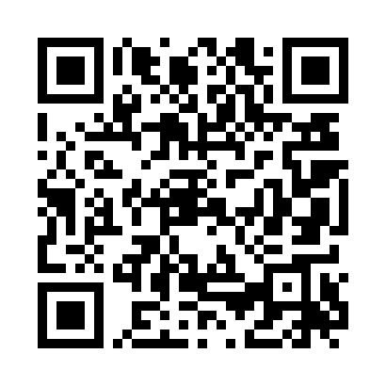
Archdiocese Requirements for Volunteers Who Have Contact with Children
The Archdiocese of Louisville requires any employee or volunteer who has contact with children for any length of time to complete a two-step process:
Archdiocesan approved background check (should be done first)
Attend an IN PERSON Safe Environment Training (SET) provided through the Archdiocese.
PTO volunteers with any contact with children are required to be sent to the Parish office for verification of compliance with this policy before we are allowed to add you to and official volunteer list.

